Slide 1
SMART WASTE MANAGEMENT SYSTEM FOR METROPOLITAN CITIES

Slide 2

A
PRESENTATION IOT Garbage Waste Monitoring System
Presented By
KARTHICK E (732319106303)
CHANDRU S (732319106002)
SAKTHIVEL P (732319106015)
YUVARAJ M (732319106024)

Slide 3
Presentation Outline
Introduction
Problem in Society
Motive of Project
Block diagram
Methodology(Hardware/software)
Application
Conclusions

Slide 4
Abstract :
This project IOT Garbage Monitoring system is a very innovative system which
will help to keep the cities clean.
This system monitors the garbage bins and informs about the level of garbage
collected in the garbage bins via a web page.
A web page is built to show the status to the user monitoring it.
The web page gives a graphical view of the garbage bins and highlights the garbage
collected in color in order to show the level of garbage collected.
The LCD screen shows the status of the garbage level.

Slide 5
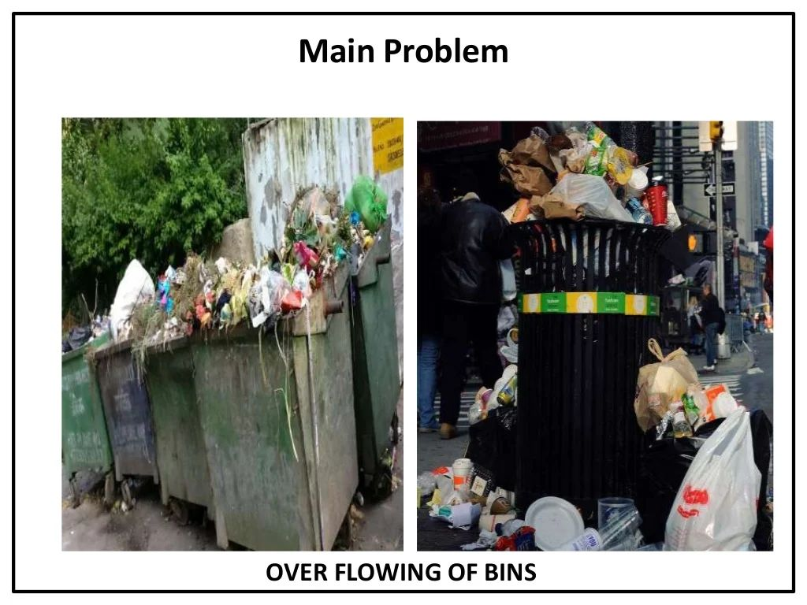

Slide 6
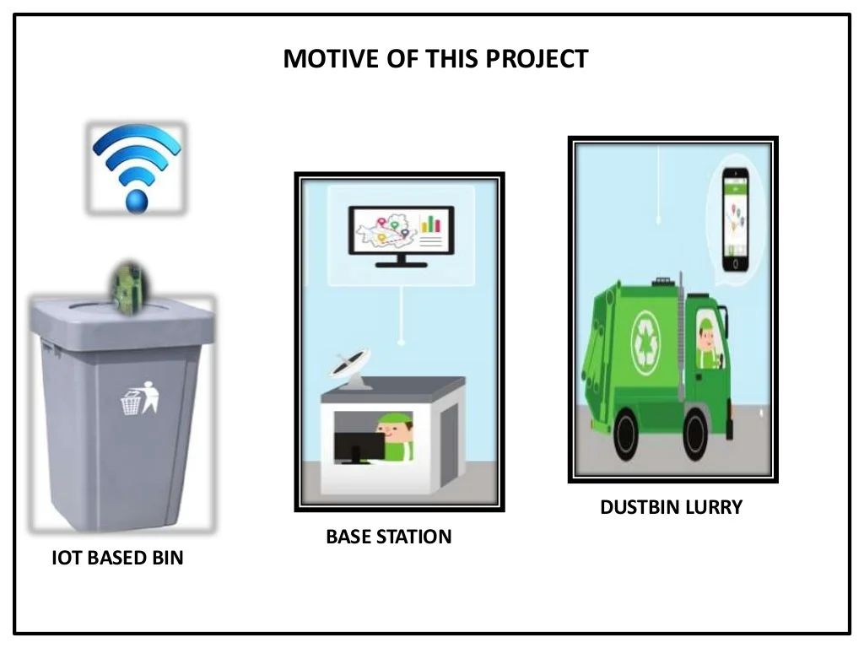

Slide 7
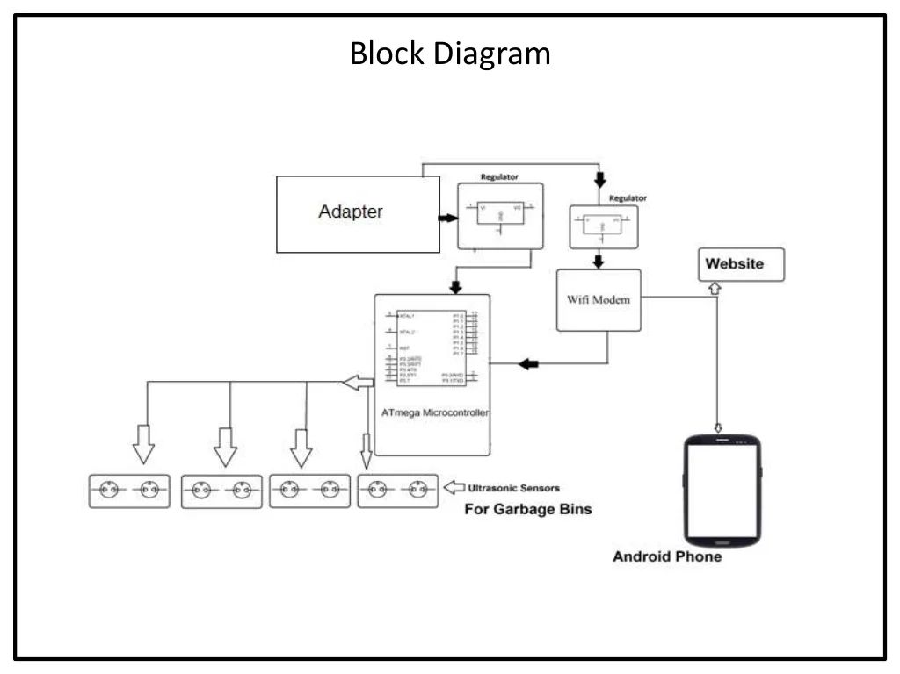
BLOCK DIAGRAM

Slide 8
Hardware / Software
Hardware Used
AVR family microcontroller
Wi-Fi Modem
LED's
LCD Display
12V transformer
Ultrasonic sensors
Resistors
Capacitors
Diodes

Slide 9
Software
Avr studio
MC Programming Language : Embedded C
Ardunino software

Slide 10
Application
Empowered Swach Bharat Mission
Reduce Environmental Pollution
Real Time Based cleaning or cities
To make our system transparent between
Municipal corporation , workers and public

Slide 11
Summary of use case….
The novel cloud-based system for waste collection in smart cities.
Integration with modern ITS and lot systems.
Development of applications for city administrations, municipal staff.

